Slide 1
Modeling Early Nephrogenesis
Recapitulating the formation of comma and s-shapes of early nephrogenesis via a particle-based polarized adhesion model. (Can I make this title longer?)

Slide 2
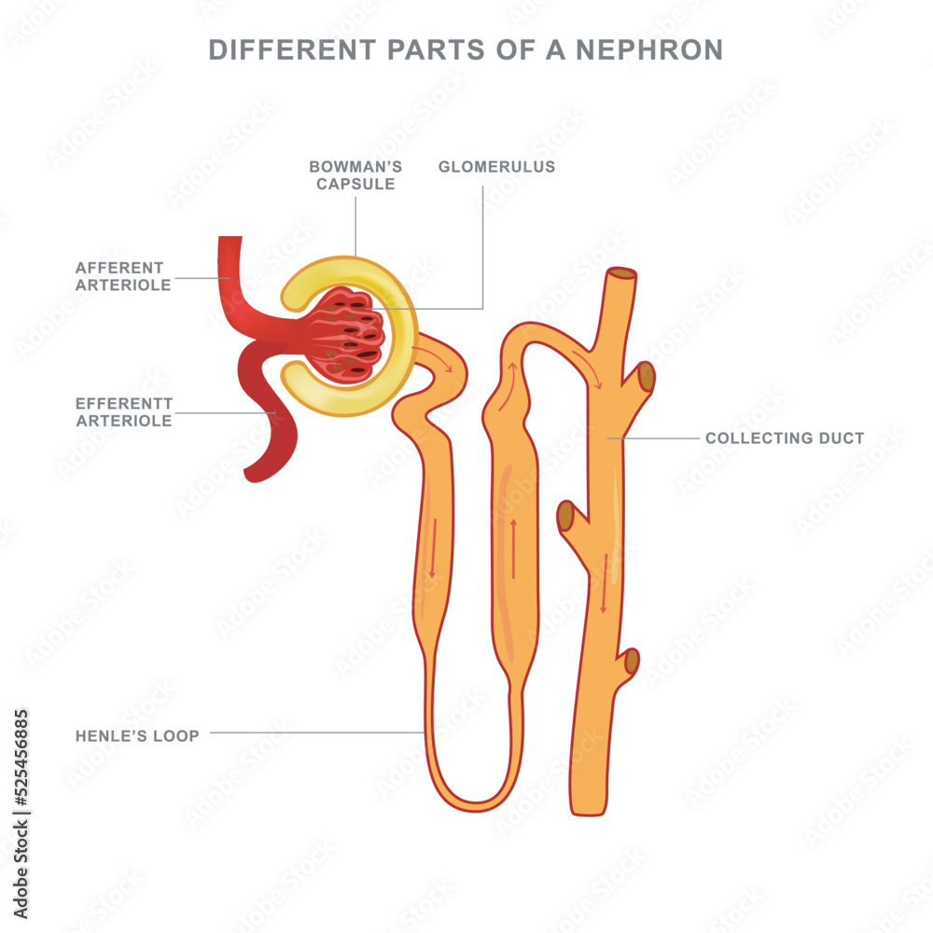
What is a nephron even?
Functional unit of the kidney
Filters toxins and metabolic waste from the blood and secrets it as urin
About a million in the human kidney and (almost) all are made before birth
(We really really really wanna know how to make more)

Slide 3
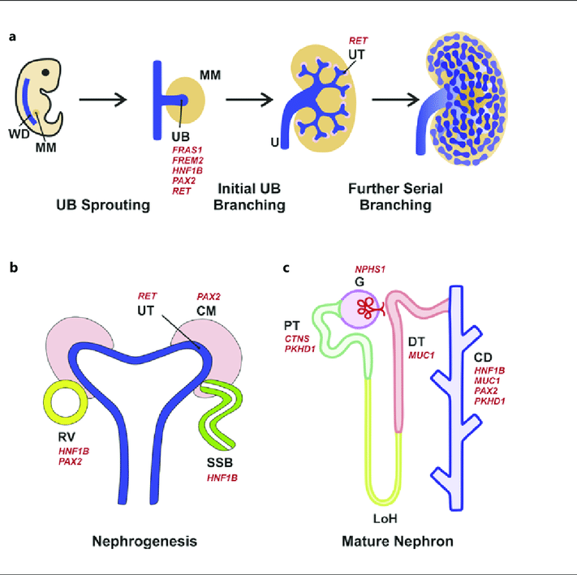
How does this nephron-thing come to be?

Slide 4
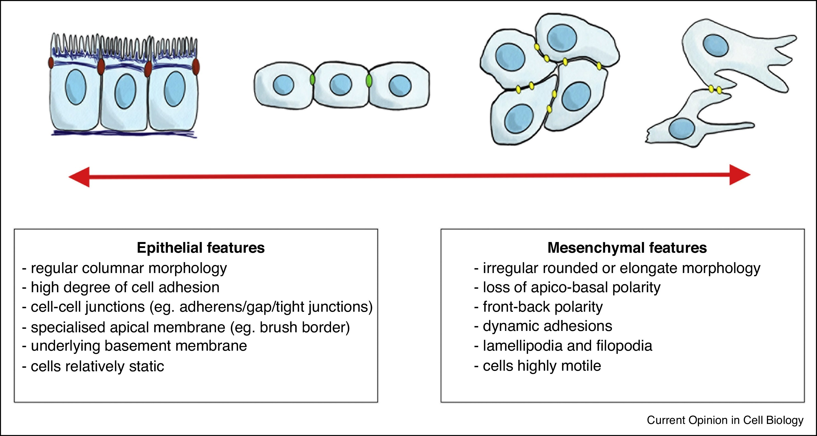
Cell types and how they change

Slide 5
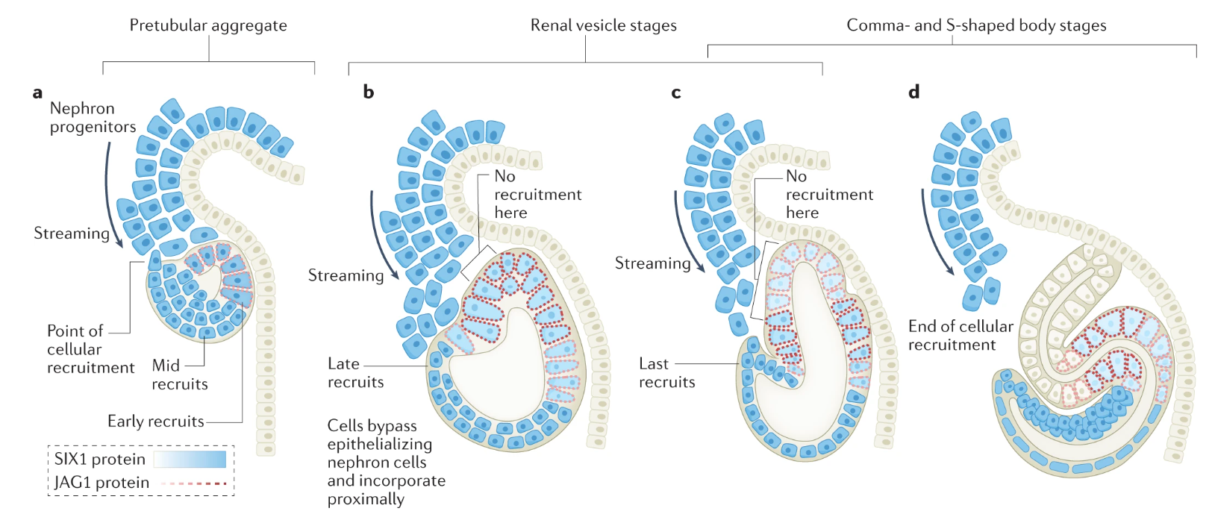
The gradual recruitment model

Slide 6
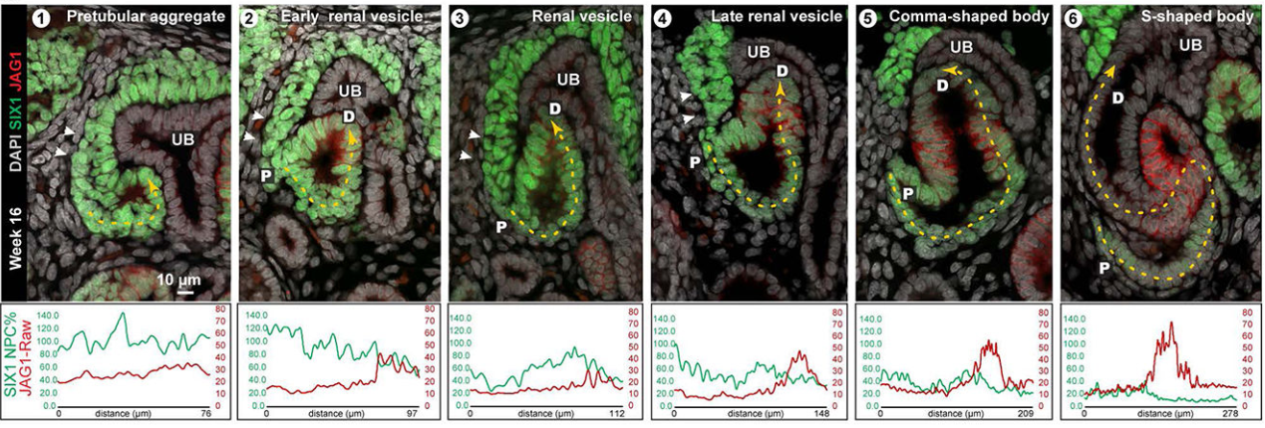
The gradual recruitment model (but real)

Slide 7
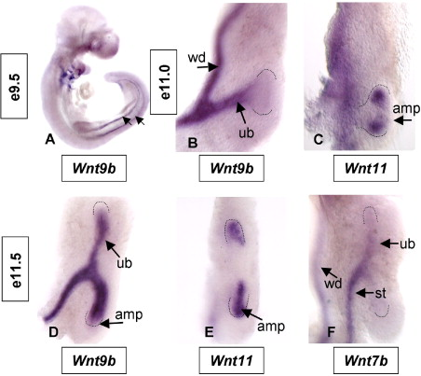
How do the cells know when to change?
Wnt9b
Secreted by the stalk early and the stalk + horizontal epithelium later
Regulates differentiation and proliferation
Concentration highest in the ‘armpit’

Slide 8
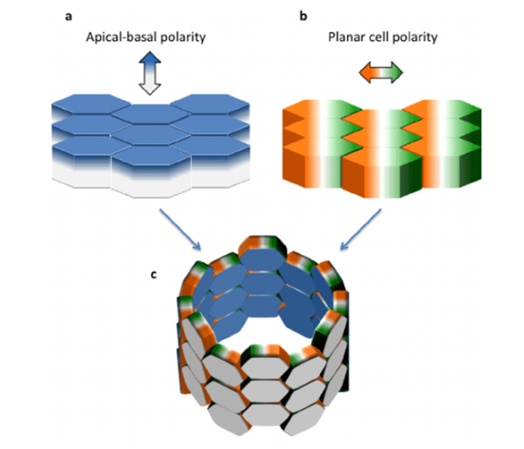
Cool – Now how do we model this?
Wait! We need to talk about cell polarity!
Apico-basal polarity (”in-out polarity”)
Apical membrane pointing outwards from body or into lumen
Planar cell polarity (”Armhair polarity”)
Orthogonal to ABP
Dictates finer structures such as armhair and fishscale direction
Important in tubes

Slide 9
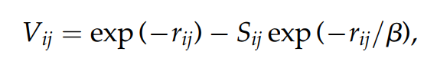
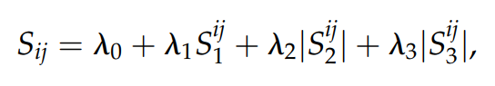
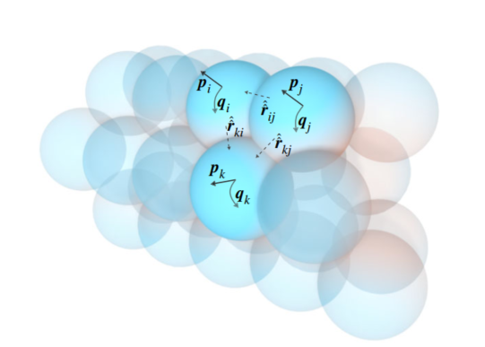
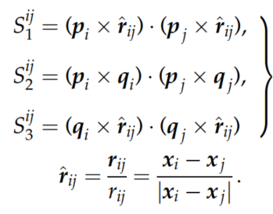
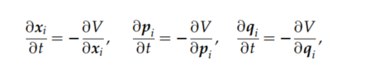
This is how we model it!
Cells only interact with voronoi neighbors
p: Apicobasal polarity , q: Planar cell polarity

Slide 10
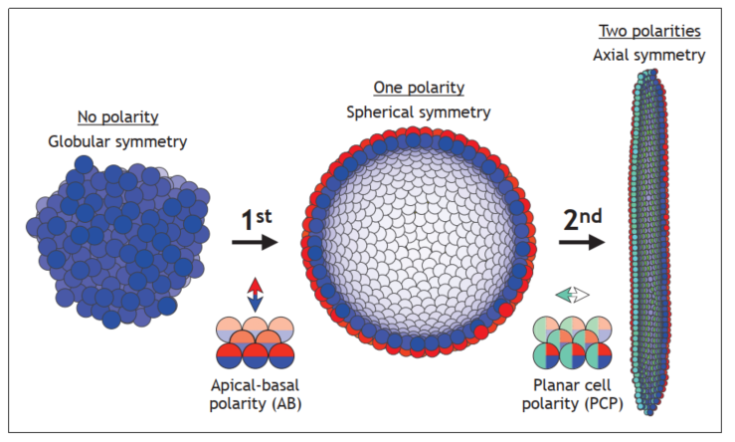
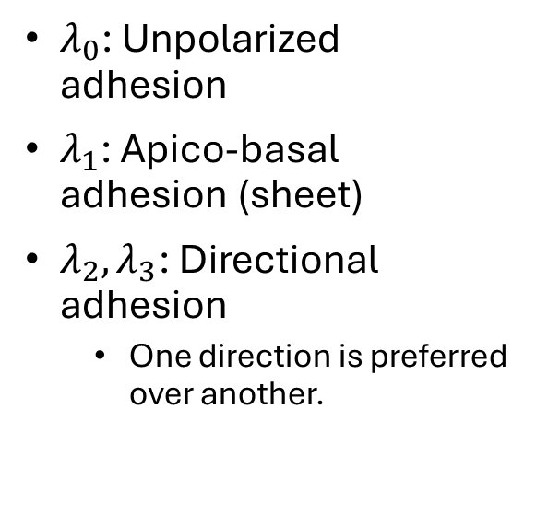
Intuition for the main model
$λ_{0}$: Unpolarized adhesion
$λ_{1}$: Apico-basal adhesion (sheet)
$λ_{2}, λ_{3}$: Directional adhesion
One direction is preferred over another.

Slide 11
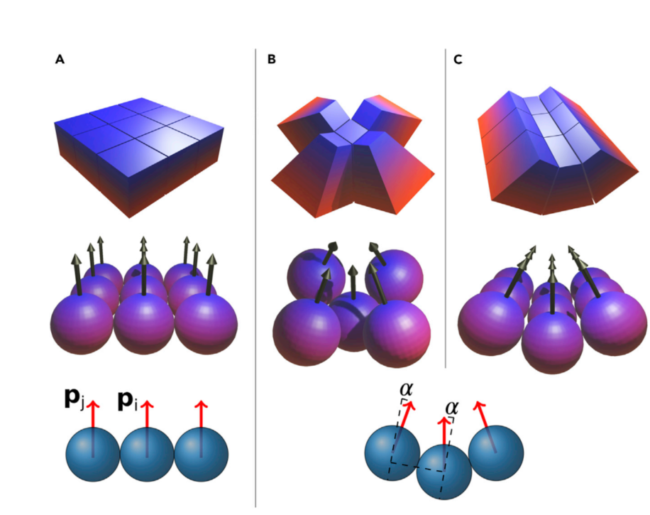
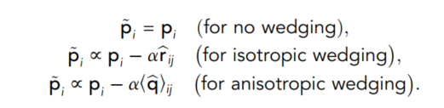
But we want to make vesicles and tubes!
Wedging!
We alter how cells ”percieve” their ABP:

Slide 12
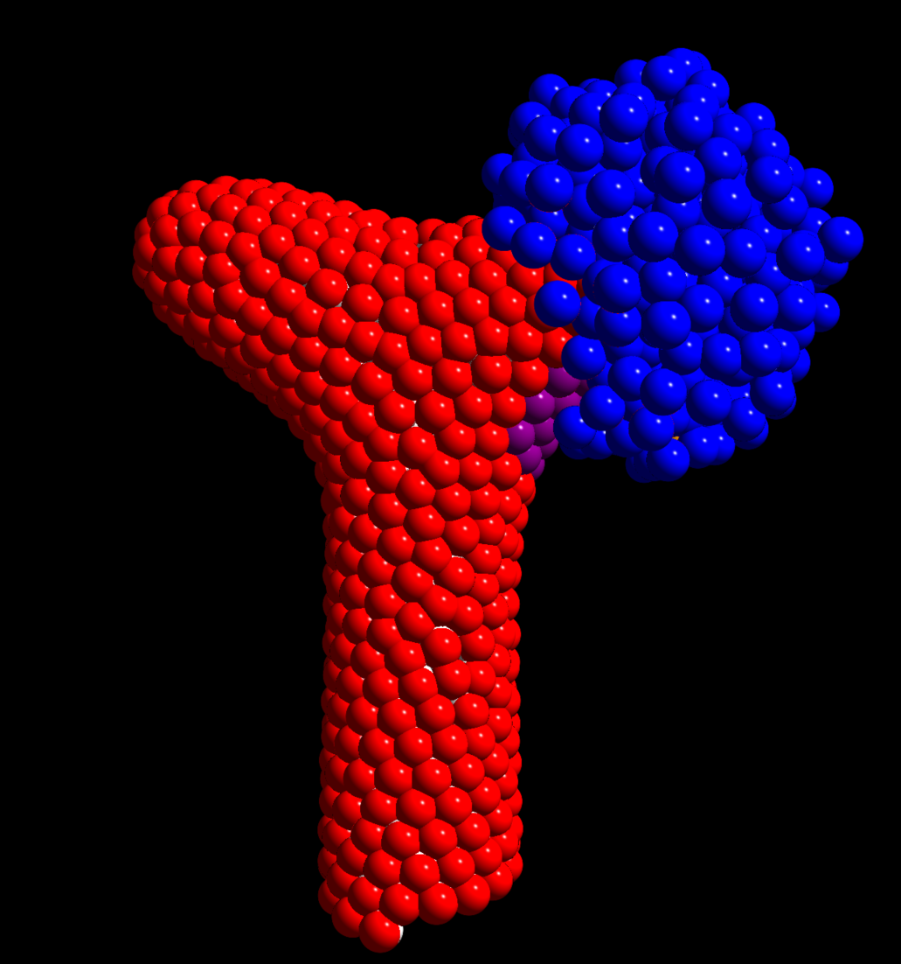
Let’s get to the actual modelling!
We first add ureteric bud (UB) and mesenchyme cells (NPC)
UB: Freeze cells and only interacts non-polarly with all other cells.
Strong interaction for ‘armpit’ (purple) to facilitate tube tethering
NPC: Only interacts with other cells if bumping into them. Subject to a chemotaxical movement.

Slide 13
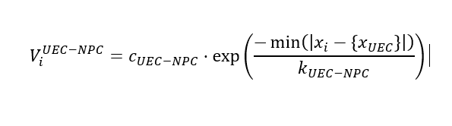
Chemotaxis
In short: Cells sense a chemical gradient in the solution and move either closer to (chemoattractant) or further away (chemorepellent) from the source
How implemented? → Additional potential
For all NPC:

Slide 14
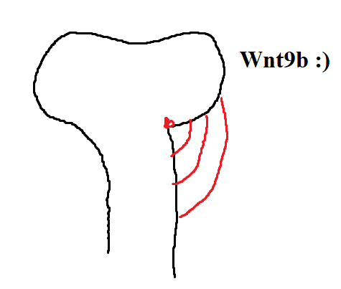
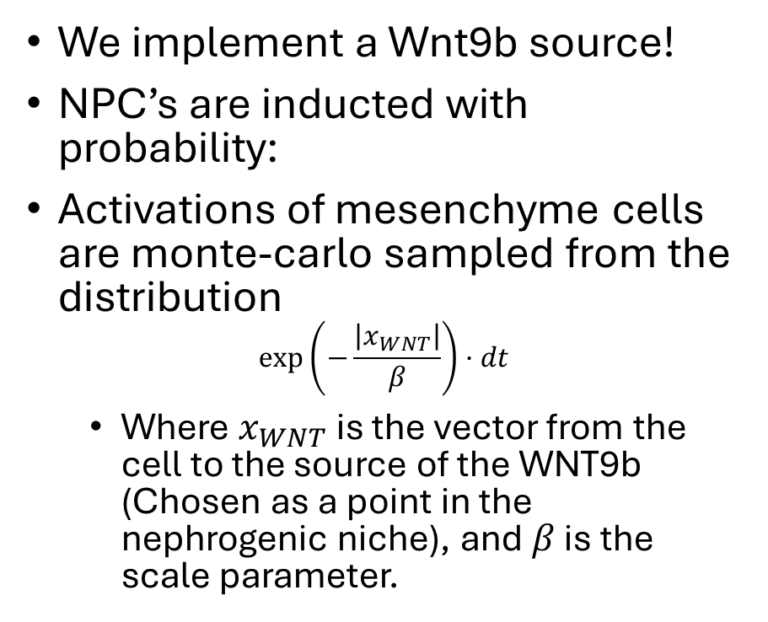
How do we get nephron-cells?
We implement a Wnt9b source!
NPC’s are inducted with probability:
Activations of mesenchyme cells are monte-carlo sampled from the distribution
$$\exp\left(−\frac{\left|x_{WNT}\right|}{β}\right)·dt$$
Where $x_{WNT}$is the vector from the cell to the source of the WNT9b (Chosen as a point in the nephrogenic niche), and $β$ is the scale parameter.
(Excuse my paint.
Some of these figures I haven’t made pretty yet)

Slide 15
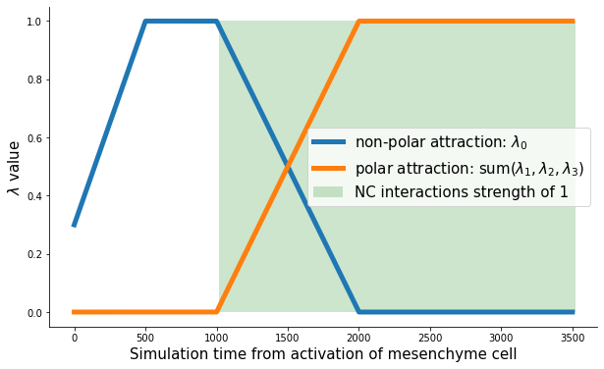
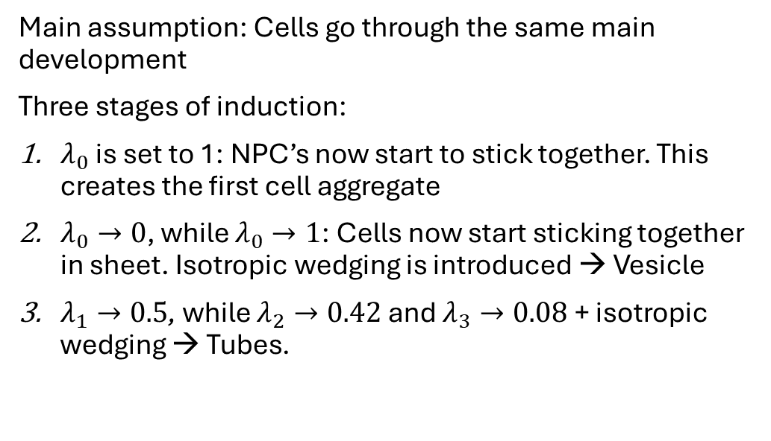
What happens when an NPC is inducted?
Main assumption: Cells go through the same main development
Three stages of induction:
$λ_{0}$ is set to 1: NPC’s now start to stick together. This creates the first cell aggregate
$λ_{0}→0$, while $λ_{0}→1$: Cells now start sticking together in sheet. Isotropic wedging is introduced → Vesicle
$λ_{1}→0.5$, while $λ_{2}→0.42$ and $λ_{3}→0.08$ + isotropic wedging → Tubes.

Slide 16
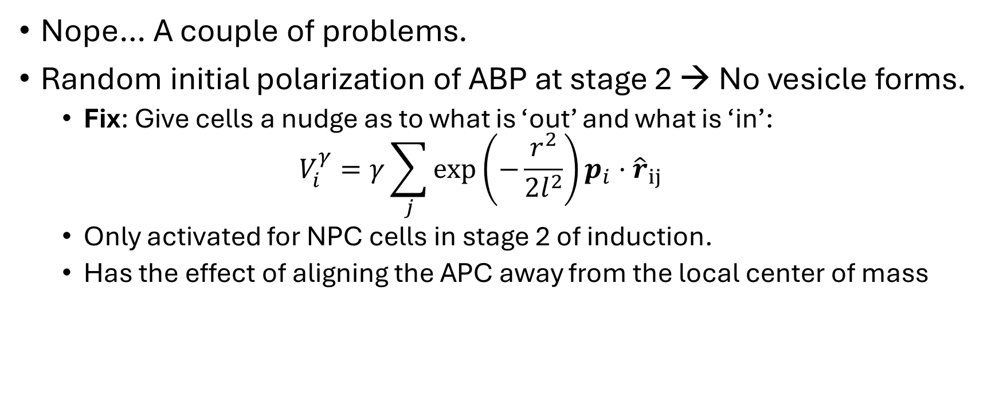
Does it work now?
Nope… A couple of problems.
Random initial polarization of ABP at stage 2 → No vesicle forms.
Fix: Give cells a nudge as to what is ‘out’ and what is ‘in’:
$$V_{i}^{γ}=γ\sum_{j}{\exp\left(−\frac{r^{2}}{2l^{2}}\right)p_{i}·{\hat{r}}_{ij }}$$
Only activated for NPC cells in stage 2 of induction.
Has the effect of aligning the APC away from the local center of mass

Slide 17
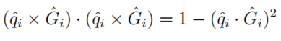
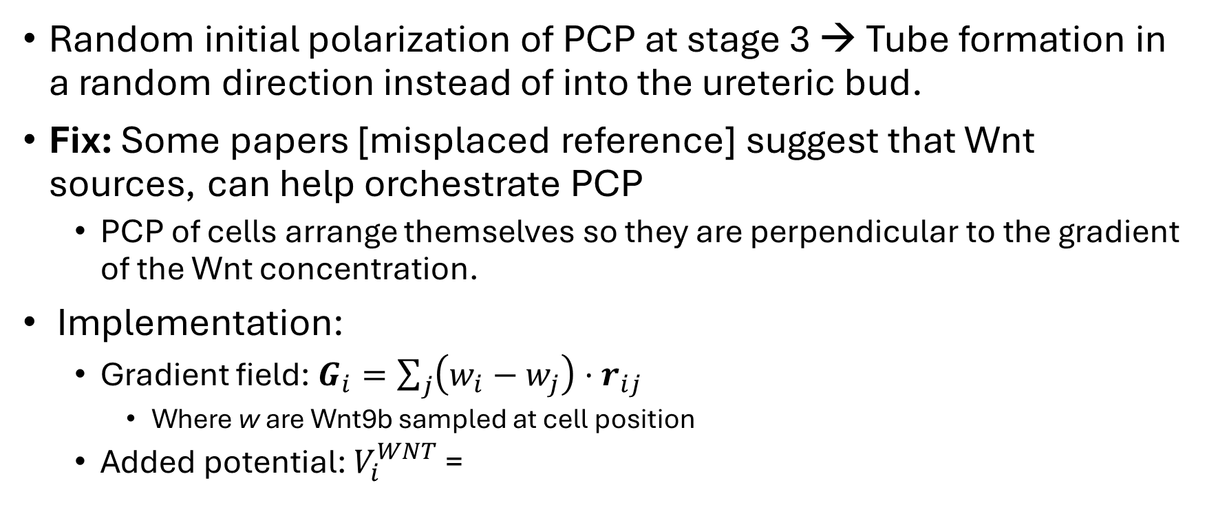
Final problem (… maybe?)
Random initial polarization of PCP at stage 3 → Tube formation in a random direction instead of into the ureteric bud.
Fix: Some papers [misplaced reference] suggest that Wnt sources, can help orchestrate PCP
PCP of cells arrange themselves so they are perpendicular to the gradient of the Wnt concentration.
Implementation:
Gradient field: $G_{i}=\sum_{j}{\left(w_{i}−w_{j}\right)·r_{ij}}$
Where w are Wnt9b sampled at cell position
Added potential: $V_{i}^{WNT}$ =

Slide 18
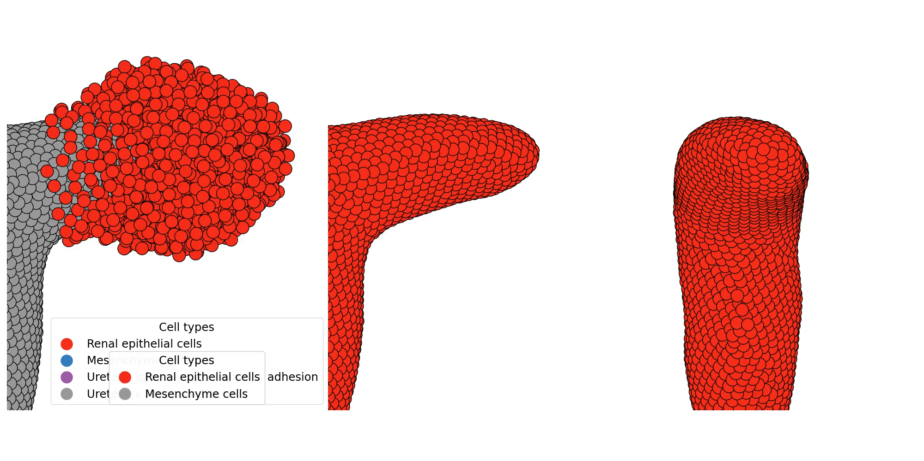
What do we get for our troubles?

Slide 19
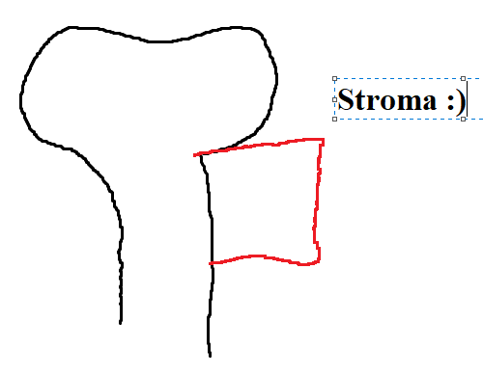
What do we get for out troubles?
Something seems to be missing: Boundary conditions (Stroma)
Implemented as hookean potentials in a cube around the forming nephron

Slide 20
… New problem
Recruitment doesn’t work as before.
New chemoattraction is implemented between the stage 1 activated NPC and the end of the forming nephron.

Slide 21
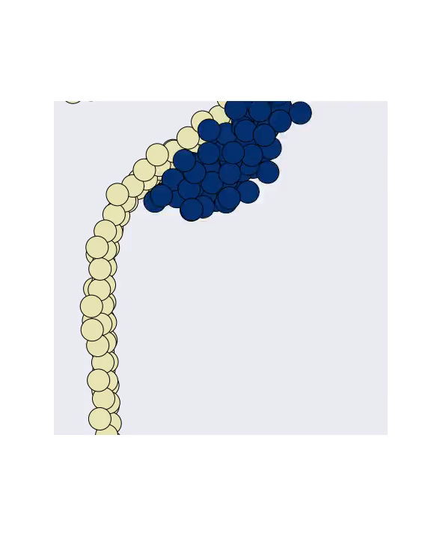
Results - Qualitatively
Comparison with Six1 expression from earlier.

Slide 22
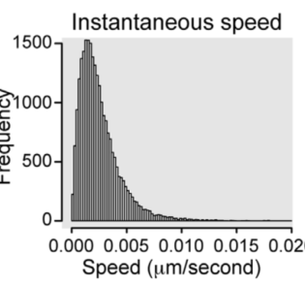
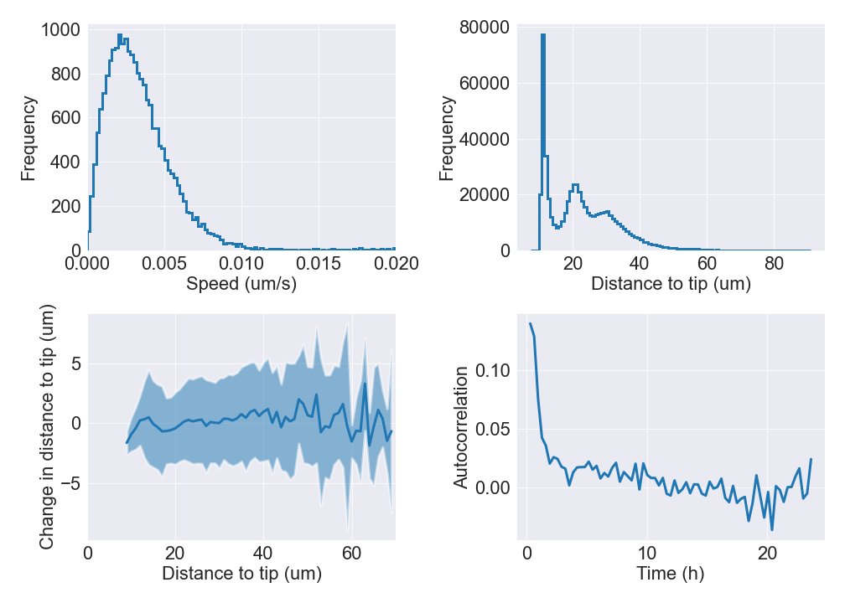
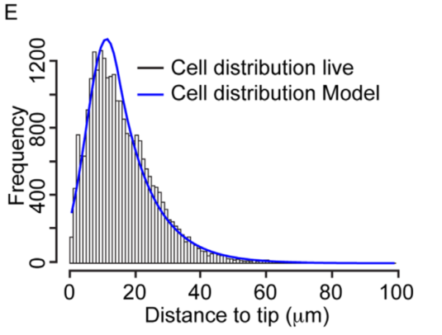
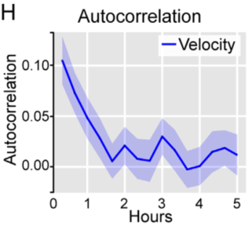
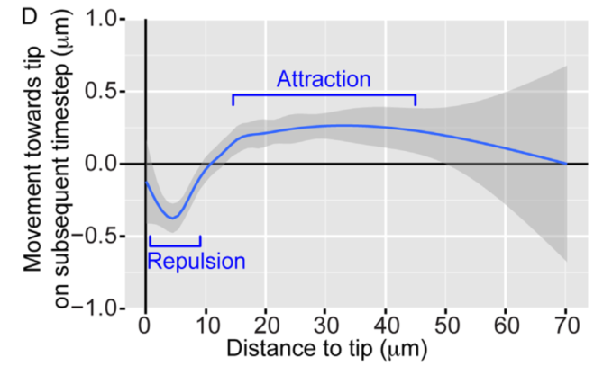
Results Quantitatively

